Slide 1
Capstone Project-Battle of Neighbourhoods
By Manoj Kumaran.R

Slide 2
Introduction
Modernization is taking its toll on the world today. The increase in the number of facilities, infrastructure etc. in a region has led in the increase of population in that area. People keep on moving to areas where these facilities are found in abundance. Also it depends on what the people like. Sometimes they prefer to be near a good school, some prefer to be near train stations, bus stops and so on. So the moving is based on things which make people happy and necessary.
And people do a lot of research on the places so they don’t waste time and money. Safety is a major factor in deciding this process.

Slide 3
Introduction-contd..
Problem :
The aim is to select the top ten places in each neighbourhood with low crime rates for a particular country. Here we use the kaggle data set for crime rates in London Boroughs from 2008-2016. We use K-means Clustering for this purpose.

Slide 4
Data Acquisition and Cleaning
The data acquired for this project is from three sources:
The first is a dataset of London crimes which contains the following columns:
Isoa_code: Area code in London
Borough: Name of London borough
Major category: High level crimes
Minor category: Low level crimes

Slide 5
Data Acquisition and Cleaning-contd..
The second is data scraped from a Wikipedia page that contains London Boroughs.
Boroughs-Names of London Boroughs
Inner-Checking if it is inner or outer London.
Status-Checking if it is royal, city etc.
Local Authority-Local Authority assigned to the Borough
Political Control-Political party that controls the Borough
Headquarters-Headquarters of the Borough
Area-Area of the Borough in miles.
Co-ordinates-Latitude and Longitude of the Boroughs

Slide 6
Data Acquisition and Cleaning-contd..
The third is also from a Wikipedia page which is created from scratch. It is the list of neighbourhoods in Royal Borough of Kingston.
Neighbourhood-Name of the Neighbourhood in the Borough
Borough-Name of the Borough
Latitude-Latitude of the Borough
Longitude-Longitude of the Borough

Slide 7
Methodology
EDA
The describe function in python is used to get statistics of the London crime data, this returns the mean, standard deviation, minimum, maximum, 1st quartile (25%), 2nd quartile (50%), and the 3rd quartile (75%) for each of the major categories of crime.
Comparing five boroughs with the highest crime rate during the year 2016 it is evident that Westminster has the highest crimes recorded followed by Lambeth, Southwark, Newham and Tower Hamlets. Westminster has a significantly higher crime rate than the other 4 boroughs.

Slide 8
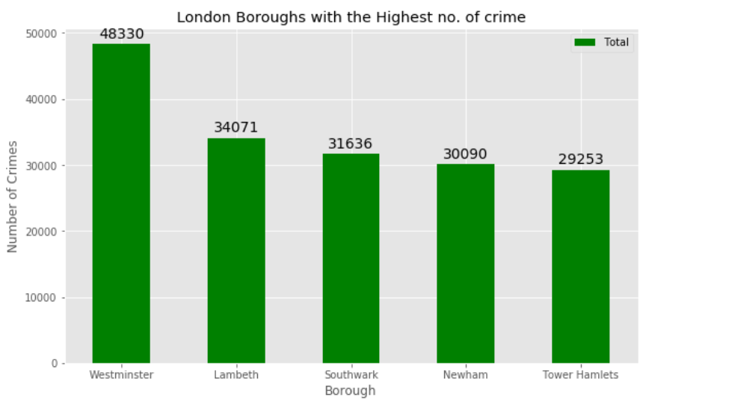
Methodology-contd..

Slide 9
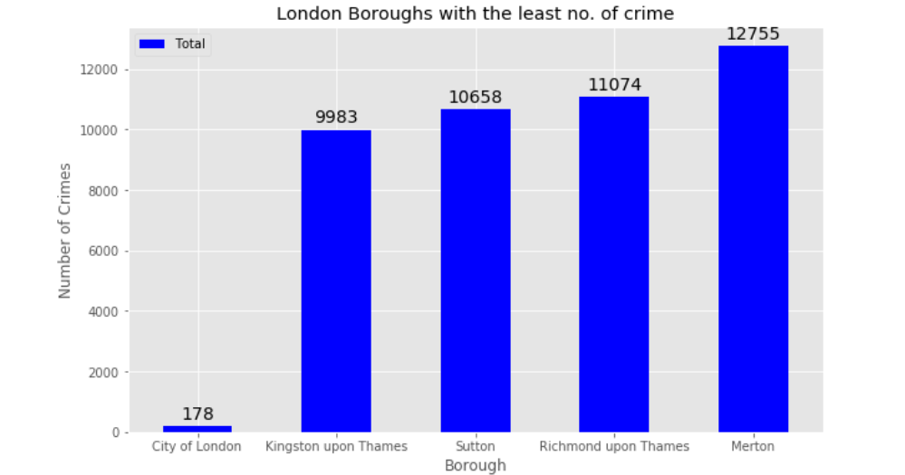
Methodology-contd..

Slide 10
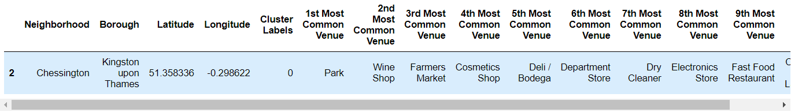
Results
Using K-means clustering we get 5 clusters:
Cluster 1:

Slide 11
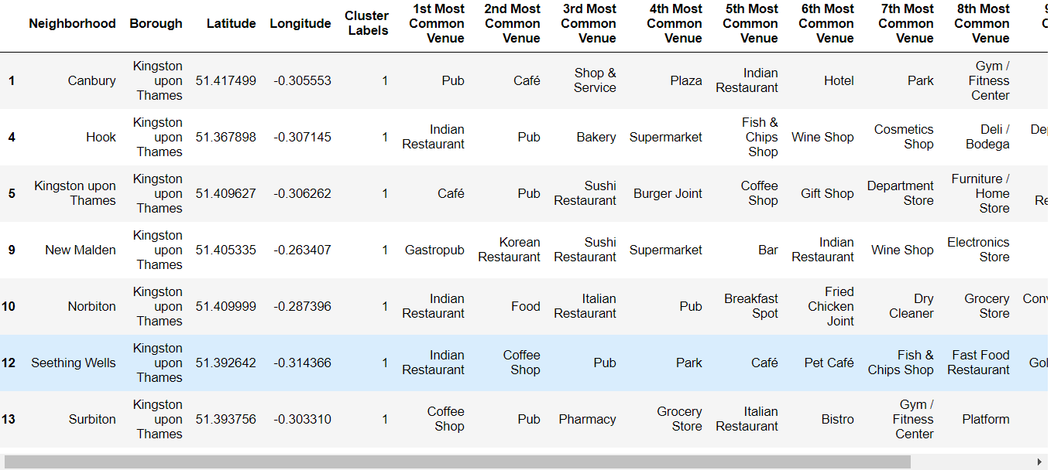
Results..
Second Cluster:

Slide 12
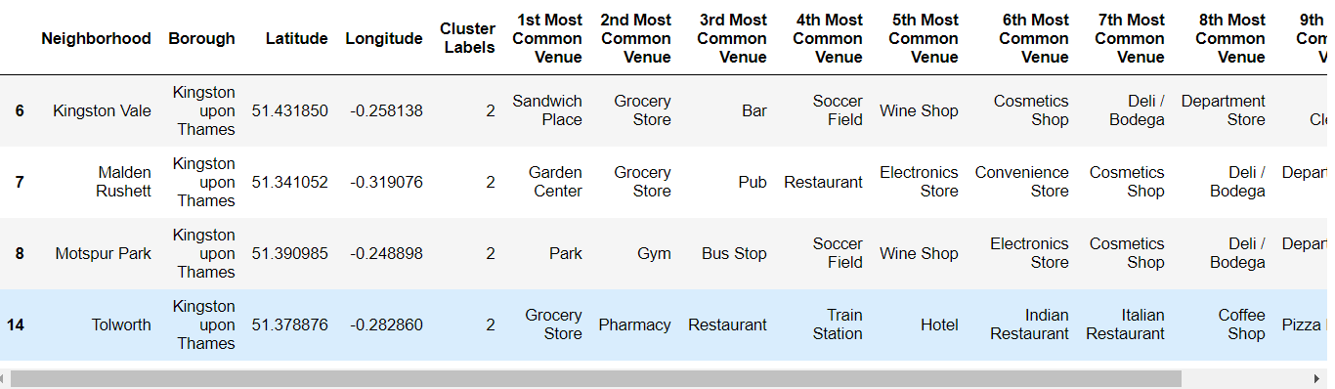
Results-contd..
Cluster 3:

Slide 13
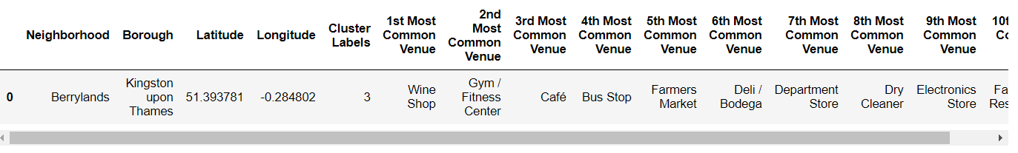
Results-contd..
Cluster 4:

Slide 14
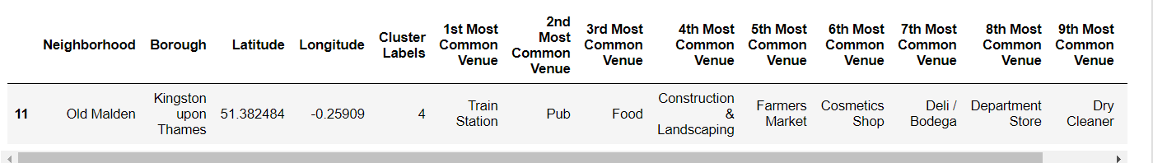
Results-contd..
Cluster 5:

Slide 15
Conclusion
So we can find out the most suitable place to live in based on these clusters. Each cluster consists of neighbourhoods, which consist of different venues.
So people can choose the locations they prefer. With the advancement of technology it would be useful for people to use it in situations which are important to them in terms of money and time.

